Slide 1
Wisconsin Medicaid Cost Reporting (WIMCR) and Comprehensive Community Services (CCS) Updates and Overview
Wisconsin Human Services Financial Management Association (WHSFMA) Conference
May 5, 2016
Public Consulting Group

Slide 2

Agenda
1. WIMCR & CCS Background
2. Cost Settlement Overview
3. 2014 WIMCR & CCS Recap
4. Improvements to the 2015 WIMCR Cost Reporting Tool
5. WIMCR & CCS Guidance
6. Timeline and Next Steps
7. Centers for Medicare and Medicaid Services (CMS) Update
8. Contacts
9. Questions

Slide 3
WIMCR Background
  Requires annual cost reporting by enrolled public Medicaid providers (i.e. county agencies and local health departments) for certain services
  Brings additional federal funds into Wisconsin through cost based reimbursement methodology
  Payments made by Wisconsin Medicaid to counties are based on:
    Actual cost-based rate
    Units of service provided to Medicaid enrolled members
A cost based reimbursement methodology determines the actual cost of delivering direct medical services

Slide 4
WIMCR Programs
Adult Mental Health Day Treatment (Medical Day Treatment services) (AMHDT)
Substance Abuse Day Treatment (SADT)
Child Adolescent Day Treatment (CADT)
Crisis Intervention (CI)
Crisis Intervention (Stabilization) per diem (CI-SPD)
Home Health (HH)
Personal Care (PC)
Outpatient Mental Health and Substance Abuse services (OPMHSA)
Outpatient Mental Health and Substance Abuse in the Home and Community for Adults (OPMHSA-HC)
Prenatal Care Coordination (PNCC)
Targeted Case Management (TCM)
Community Support Program (CSP)

Slide 5
CCS Background
Mental health and substance abuse programs
Provides programming to people of all ages—youth to elderly—living with a mental illness and/or substance use disorder
CCS is for individuals who need ongoing services beyond occasional outpatient care, but less than the intensive care provided in a hospital setting
The individual works with a dedicated team of service providers to develop a treatment and recovery plan to meet the individual's unique needs and goals
A 2013 study of the consumer experience in CCS found that this targeted, community-based approach is effective in promoting better overall health and life satisfaction
CCS reduces an individual's reliance on costly high-end services, such as emergency room visits.

Slide 6
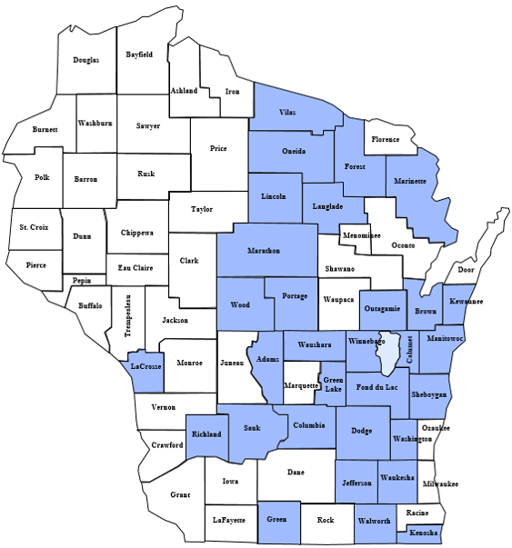
Participating CCS Programs
Prior to regionalization effective July 1, 2014
CCS Counties (31 counties including counties that are part of 51.42 agencies)
Non-CCS Counties

Slide 7
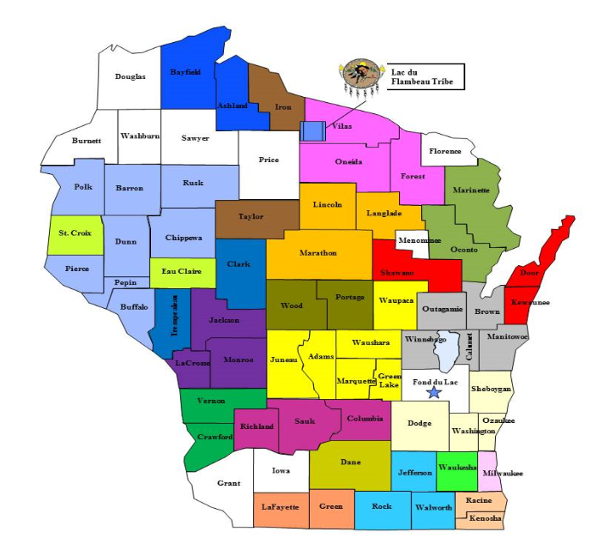
Participating CCS Programs
Regional participation as of March 2016
62 counties and one tribe currently in CCS (includes Fond du Lac as non-regional participant)
Color coding reflects 24 regional CCS entities:
18 county-based programs
3 population-based programs
2 51.42 programs
  Multiple counties that have partnered together to form a separate 51.42 legal entity operate a regional CCS program through the 51.42 entity.
1 tribal-based program

Slide 8
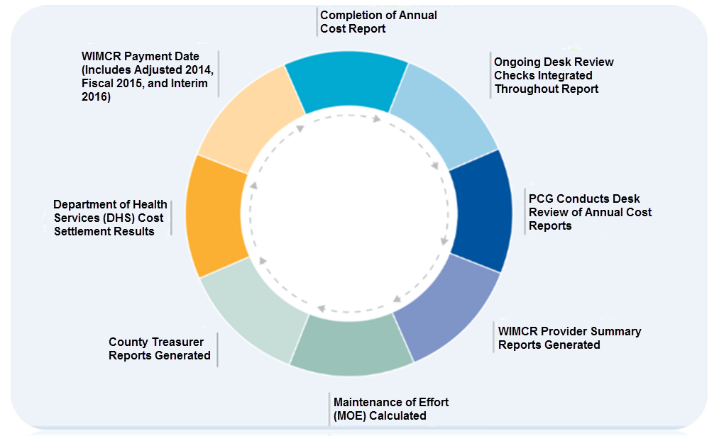
Cost Settlement Overview

Slide 9
Cost Settlement Overview
County Agency Overview
Total cost and FTE information for the entire agency
WIMCR Direct Service Checklist
Programs, Provider IDs and Professional Types
Direct Service and Support
Salary and benefits by profession and service
Supplemental Direct Service Information
Additional information based on unique agency circumstances
General Admin Overhead
Allocation of agency overhead
Federal Funds and Reductions
Federal grant dollars applied to offset the cost of agency’s programs
Summary and Certification
Management Reports
Provider Summary Reports and County Treasurer Reports

Slide 10
2014 WIMCR/CCS Recap

Slide 11
2014 WIMCR Cost Report Recap
99% Participation
77 Counties
112 Agencies

Slide 12
2014 WIMCR Cost Report Recap
WIMCR Program | Direct Service | Direct Support | Overhead
AMHDT | 48.81% | 18.04% | 33.15%
CSP | 53.35% | 30.13% | 16.53%
CI | 55.78% | 31.90% | 12.32%
CI-SPD | 100.00% | 0.00% | 0.00%
HH | 38.59% | 34.71% | 26.70%
OPMHSA | 45.81% | 34.94% | 19.25%
OPMHSA-HC | 89.26% | 1.88% | 8.87%
PC | 85.30% | 7.56% | 7.14%
PNCC | 52.00% | 24.35% | 23.64%
SADT | 28.22% | 55.81% | 15.96%
TCM | 55.27% | 28.01% | 16.72%

Slide 13
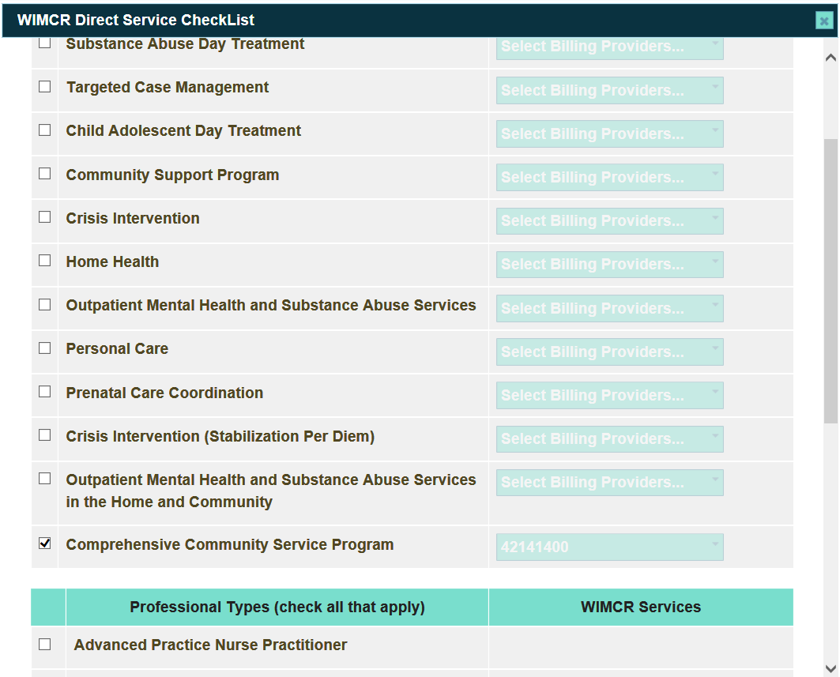
Improvements to the 2015 WIMCR Tool
CCS integration in the WIMCR tool

Slide 14
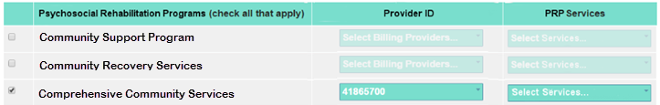
Direct Service Checklist
Direct service checklist for Psychosocial Rehabilitation
Psychosocial Rehabilitation services are provided to enable recipients to better manage the symptoms of their behavioral health issues, to increase their independence, and to achieve effective levels of functioning in the community and at home.
Psychosocial rehabilitation services can provide services in an individual, family, or group setting.
*Community Recovery Services (CRS) are currently not part of the cost settlement process.

Slide 15
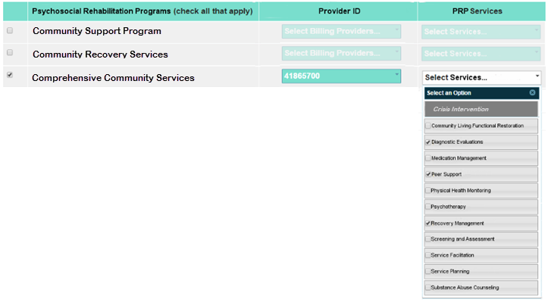
Direct Service Checklist
Direct service checklist with service level checklist

Slide 16
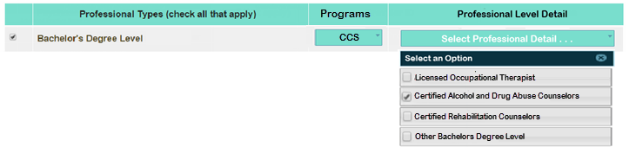
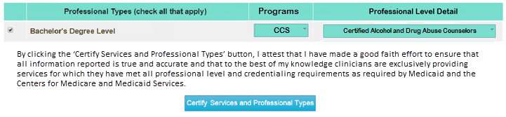
Direct Service Checklist
Professional Types
Professional Type Detail
Professional detail selected and certification

Slide 17
Certification Page

Slide 18
WIMCR/CCS Guidance and Compliance
1. WIMCR/CCS Guidance
  Intergovernmental agreements
  Group participant units
  CCS start up costs
2. CMS Compliance Questions and Answers
  County agency overview guidance
  Overhead allocation for contractors
  Direct support and overhead personnel
  Federal funds and reductions
  Time Tracking
  Reasonable costs
  CRS updates
3. Community Aids Reporting System (CARS) Payments

Slide 19
WIMCR/CCS Guidance

Slide 20
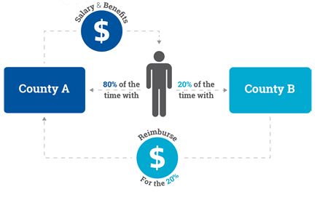
1.A. - Intergovernmental Agreements
Intergovernmental Agreements Terminology
Intergovernmental Agreements: An intergovernmental agreement occurs when an employee of one county or tribal reporting entity provides services on behalf of a second reporting entity and the second reporting entity reimburses the first reporting entity for services provided. The graphic to the right shows an example of an intergovernmental agreement.
Regional Shared: The term regional shared is used to identify an individual or a category of overhead used to support multiple counties.
Revenue Offset: A revenue offset is the dollar amount paid from one county to another for services provided by a regional shared clinician or overhead provider.

Slide 21
Intergovernmental Agreements
CCS counties have the flexibility to enter into contractual arrangements for service provision either among regional county entities or with non-county contractors.
  A region may contract with a county outside of the region for services. This outside county would be treated as a subcontractor and would not have a county section on the cost report.
WIMCR counties may enter into contractual arrangements for service provision with neighboring counties.
If counties or tribes opt to contract with other counties or tribes within their region each must report the appropriate revenues and expenditures to avoid double-counting costs.
The county or tribe employing all shared staff:
  Reports total salary and benefits paid to each shared employee
  Reports a revenue offset for all contract revenue received from another county or tribe for services provided by the regional shared employee.
  Reports total hours for direct service or Full Time Employees (FTEs) for overhead, as well as an offset for hours worked on behalf of another reporting entity.
The county or tribe which has contracted for a portion of the shared staff’s time:
  Reports contract cost that is paid to the county who is employing the shared staff.
  Reports hours (direct service) or FTEs (overhead) working for their county.

Slide 22
Direct Service Intergovernmental Agreements Example
The example below demonstrates how a regional shared clinician should be reflected on the cost report of the county or tribe employing the shared clinician (County A) as well as the county or tribe contracting out for the shared clinician’s services (County B).
Intergovernmental Agreement Example - Direct Service
Overview
County A Basic
County A Cost
County A
County B Basic
County B Cost
County B
Information
Hours
Information
Hours
County A
County A
County A
CCS Direct Service Clinician:
Clinician 1 is a full time
reports
reports salary
reports total
County B
employee of County A (40 hrs per week,
2080
hours per
Clinician 1 as
of
$50,000
,
paid hours of
reports
County B
County B
year), receiving a salary of
$50,000
and benefits of
an "Agency
benefits of
2080
, and
Clinician 1 as
reports
Reports
10% or
$20,000. Clinician 1 spends
10%
of their time
Employee -
$20,000
and a
"Region
a "Contractor -
$15,000
208
CCS
providing CCS direct services on behalf of County B.
Regional
Regional
Direct" hours
Regional
contract cost
Direct Service
County B pays County A
$15,000
for Clinician 1's time.
Shared", and
Revenue
of
208 (or
Shared" and
Hours
reports an NPI
Offset of
10%)
reports an NPI
$15,000
.

Slide 23
Overhead Intergovernmental Agreement Example
The example below demonstrates how a regional shared overhead provider should be reflected on the cost report of the county or tribe employing the shared employee (County A) as well as the county or tribe contracting out for the shared employee’s services (County B).

Slide 24
1.B. - Group Participant Units
Duplicated Participant Count terminology has transitioned to Group Participant Units
  Group Participant Units: the total number of participants attending all group services units.
Example: For two CSP group sessions, one session has 11 participants and the other session has 15 participants. Assuming the sessions were for 15 minutes each, the total group participant units would be 26 units. Even if four participants attend both sessions, the total is still 26 units.
  Group 1: Participants x Units = 11 x 1 = 11
  Group 2: Participants x Units = 15 x 1 = 15
  Total: 26 Group Participant Units
Program | One unit of group service
CCS and CSP | 15 minutes
OPMHSA and OPMHSA-HC | 1 hour
PNCC (multiplied by the conversion factor for H1003) | Unit is converted from 1 visit

Slide 25
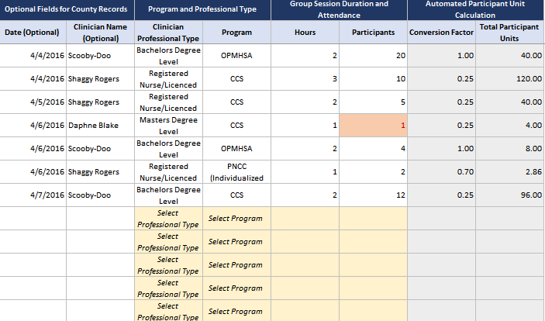
Group Services Tracking Template

Slide 26
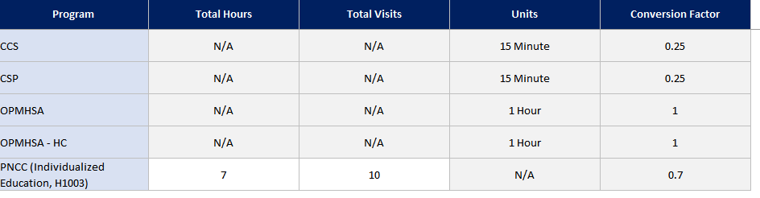
Group Services Tracking Template – PNCC Conversion Factor

Slide 27
1.C. - CCS Start up Costs
Start up Costs: non-recurring costs associated with setting up a CCS program prior to the provision of direct services.
*Unallowable start up costs per CMS direction.
Allowable start up costs are the costs incurred after DQA certification of the CCS region
Examples include equipment, program director, salary and hours, and rent
Unallowable start up costs are incurred prior to DQA regional certification
New regions must have DQA regional certification even if all the counties were DQA certified as single county programs

Slide 28
CMS Compliance Updates

Slide 29
2.A. County Agency Overview Page
Question: How does CMS ensure that WIMCR/CCS costs align with each county’s single audit?
Cost information on the County Agency Overview screen within the WIMCR/CCS cost report must align with total expenditures during the reporting period as documented in the county agency’s general ledger.
Each county agency will need to attest that their cost report is in compliance with A-133 Single Audit
Cost information:
  Personnel Expenditures and Operational Expenditures
    Must reflect all cost incurred by the county agency during the calendar year reporting period as documented within financial reports maintained by the county agency.
  Interdepartmental Charges
    Must reflect the portion of county wide overhead cost allocated to the county agency. Interdepartmental Charges reported must align with the county-wide cost allocation plan required by federal Cost Allocation Services.
    The method must be the same cost allocation method as performed county-wide under the cost allocation plan and must be supported by corroborating cost allocation documentation.
* Agencies are required to submit general ledger pages that corroborate the expenditures listed on the County Agency Overview screen.

Slide 30
2.B. Overhead Allocation for Contractors
Question: For WIMCR/CCS cost reporting, when may overhead be allocated to contractors?
Counties may only allocate overhead costs to contractors if the allocation is consistent with the county’s cost allocation plan for central service costs.
County-wide central service overhead and department overhead may only be applied to contractors, for WIMCR/CCS cost reporting purposes, if the county applies overhead rates to contractors according to the county-wide cost allocation service method, as well as according to the county government budget development method.
The state will review county cost allocation plans at its discretion to verify consistency between the county-wide cost allocation plan method and the contractor allocated overhead method for WIMCR/CCS cost reporting.

Slide 31
2.C. Direct Support and Overhead Personnel
Question: When is it appropriate to report overhead and direct support staff that are supervisory, administrative or clerical in nature?
Supervisors and county administrative staff may be reported if the agency is in compliance with 2 CFR § 200, Subpart E, Section 200.413(c).
  Direct costs: The compensation of administrative and clerical staff may be reported if the employees meet the following conditions:
    administrative or clerical services are integral to a project or activity;
    individuals involved can be specifically identified with the project or activity,
    and these costs are not also recovered as overhead
In accordance with Appendix VII 2 CFR § 200 D.1.a, “All departments or agencies of the governmental unit desiring to claim indirect costs [Direct Support and Overhead personnel] under Federal awards must prepare an indirect cost rate proposal and related documentation to support those costs”. Additionally, a non-federal entity may utilize a cost allocation plan if it is the case an indirect cost rate is not used.

Slide 32
2.D. Federal/State Funds and Reductions
Question: When is it necessary to report federal funds and reductions?
Items to report under Federal Funds and Reductions
Any federal funding source received by a county and used to fund WIMCR costs
Examples of federal funding sources that might need to be reported:
  Mental Health Block Grant
  Substance Abuse Block Grant
  Social Services Block Grant
  Birth to three allocation applied to WIMCR TCM
Items to exclude from Federal Funds and Reductions
Any funding source that is not applied to any WIMCR cost
Any state funding that is used to cover the local share of WIMCR cost
Medicaid fee for service payments received - these will automatically be netted out of the final cost settlement as part of the Provider Summary Report (PSR) calculation
Basic County Allocation (BCA)
Maintenance of Effort (MOE) dollars

Slide 33
2.E. Time Tracking
Question: How must counties ensure that they are accurately reporting and keeping records that reflect the division of direct service and direct support time/costs?
Counties must have a method in place to segregate time/costs applicable to WIMCR/CCS services and maintain the records of the allocation of time.
Counties may use the following options to track time. Other methods of time tracking must be approved by DHS prior to reporting.
  Personnel activity reports (PAR) or employee day log
  Time Studies (with CMS approval)
    Note: If a county opts to use a time study, they must submit their plan to the State during the reporting period and the State will verify the county methodology with CMS.
CMS requires that approved time tracking methodology documentation must be maintained.
  Documentation must be available on request during monitoring reviews and financial audits.
  Without proper documentation, costs associated with Direct Service, Direct Support, and Overhead Personnel are unallowable costs

Slide 34
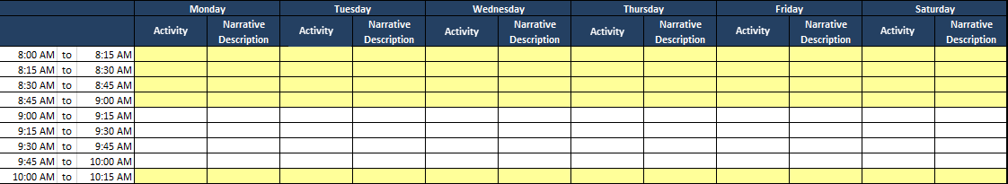
Time Tracking Personnel Activity Report (PAR)
Time tracking should capture the activities of every employee at each 15-minute interval for all hours worked.
All time should be recorded including:
  WIMCR/CCS direct service
  WIMCR /CCS direct support
  Other Non WIMCR/CCS hours
  PTO hours

Slide 35
2.F. Reasonable Costs
Question: What are allowable and reasonable cost for WIMCR/CCS reporting purposes?
In order to be considered reasonable, costs shall not exceed that which would be incurred by a prudent person under the circumstances prevailing at the time the decision was made to incur the cost.
  Reported cost must correspond to existing financial reports, county wide cost allocation plans and additional supporting documentation maintained by each entity for the reporting period. See 2 CFR 200 (herein referred to as OMB Circular A-87); and the Provider Reimbursement Manual, CMS Publication 15-1.
In determining reasonableness of a given cost, OMB Circular A-87 states that consideration must be given to:
  Whether the cost is of a type generally recognized as ordinary and necessary for the operation and performance of the function for which the cost was incurred.
  The restraints or requirements imposed by such factors as sound business practices; arms-length transactions; Federal, State, and other laws and regulations; and terms and conditions of the Federal award or entitlement.
  Market prices for comparable goods or services.
    The necessity of contracting for the service, considering the governmental unit's capability in the particular area.
    Whether the service can be performed more economically by direct employment rather than contracting.
  Whether the individuals concerned acted with prudence in the circumstances considering their responsibilities to the county agency, its employees, the public at large, and the Federal Government.
  Significant deviations from the established practices of the county agency which may unjustifiably increase the Federal awards’ cost.
*The financial liability for fringe benefit and pension costs for retirees not associated with the ordinary and necessary operation of WIMCR/CCS programs are not considered reasonable costs.
** Room and board and the vaccines in VFC programs are not considered reasonable costs.

Slide 36
2.G. CRS Update
Question: Has CRS obtained State Plan Approval?
CRS is a mental health program with a focus on providing services to enable the individual to mitigate the impact of mental illness and live independently in the community and to reduce the incidence and duration of institutional treatment for mental illness.
The 1915(i) State Plan Amendment (SPA) (09-017) articulates cost settlement/reconciliation for CRS. Wisconsin Medicaid has not yet completed this process with counties for any year for the program (2010-present) because we do not have a trial balance process approved with CMS.
DHS continues to work with CMS on transitioning CSP (in WIMCR), CCS, and CRS into a single comprehensive psychosocial rehabilitation benefit by updating the Wisconsin SPA to receive authorization for the comprehensive program under Section 1905 authority.

Slide 37
CARS Update

Slide 38
3.A. CARS Update
Normally, WIMCR receivables are moved from the prior year contract (in this case CY15) to the current year contract (in this case CY16) in January of each year before any CY16 payments are made. This move occurs on CARS profile 1007. It is done in January before any CARS runs are performed to allow counties to trace the calculated adjustment from the County Treasurer Reports (CTR) to CARS.
For CY16, the WIMCR receivables were not moved from the CY15 to CY16 contracts in January due to an oversight. Instead, this receivable move on profile 1007 occurred on CARS voucher 90624 in May 2016.
Because some of the CY15 receivable amounts had already been recouped against costs reported on the CY15 contracts between January-April, the May CARS voucher (90624) included a payment adjustment between contract years for the WIMCR receivable. Counties should have seen an increased payment on CY15 contracts for the amount that had been previously recouped against CY15 and a decreased payment on CY16 contracts for the corresponding amount.

Slide 39
Timeline and Next Steps
CY2015 Cost Report
6/13/16 – 8/5/16
Desk Review for CY2015
8/5/16 – 9/2/16
Tentative Timeline for WIMCR/CCS Reporting
In Person and Webex Trainings on CY2015 Cost Report
6/20/16 – 6/24/16
Management Reports of CY2015
9/5/16 – 12/19/16

Slide 40
Contact Us
WIMCR Support
Alissa Kordrupel
Mitchell Perry
Megan Morris
WIMCR@pcgus.com
WICCS@pcgus.com
(866) 803-8698
Additional Resources
WIMCR Reporting Site: wimcr.com
CCS Landing Page: wimcr.com/CCS
DHS Contact
Steve Milioto
DHS Division of Healthcare Access and Accountability
Steve.Milioto@wisconsin.gov
Phone: 608.266.3802

Slide 41
Questions?

